Slide 1

UCD PAPER PRESENTATION • AI WEATHER FORECASTING Sept 14, 2026
KARINA: An Efficient Deep Learning Model for Global Weather Forecast
A breakthrough $2.5^\circ$ resolution model delivering high-accuracy weather predictions in under 12 hours of training on 4 NVIDIA A100 GPUs.
AUTHORS
INSTITUTION
PUBLICATION
M. Cheon, Y. Choi, S. Kang, Y. Choi, J. Lee, D. Kang
KIST Center for Sustainable Environment Research
arXiv:2403.10555v1 (March 2024)

Slide 2



MOTIVATION
The Computational Bottleneck
State-of-the-art weather AI models require massivecomputing resources​
Pangu-Weather: 192 GPUs for 64 days​
KARINA aims to deliver similar accuracy with far lowercost​
st
https://nvidianews.nvidia.com/_gallery/get_file/?file_id=682989ae3d6332f015179abf

Slide 3


METHODOLOGY
KARINA Architecture Overview
ConvNeXt Backbone
Modernized deep spatial feature extraction.
Geocyclic Padding
Eliminates artificial edge discontinuities.
SENet Recalibration
Dynamically weights 66 atmospheric variables.
https://elements-resized.envatousercontent.com/elements-video-cover-images/2ee0cc55-7376-4c5b-83b9-79768a13fb83/video_preview/video_preview_0000.jpg?w=500&cf_fit=cover&q=85&format=auto&s=ad6f66c219e04d5e23509c627e5cd217a4dd527d4fab84887f60af5f52ff5f11

Slide 4

EXPERIMENTAL RESULTS
Compute Benchmarks & Forecasting Skill
Variable | Day 1 RMSE | Day 7 RMSE | vs ECMWF S2S
Z500 | 52.78 | 463.65
T850 | 0.82 | 2.85
T2M | 0.94 | 2.42
Outperforms
Outperforms
Outperforms
*KARINA closely matches SOTA models (ClimaX, GraphCast) up to 7-day lead times while using a fraction of the computational resources.

Slide 5


CONCLUSION
Advancing "Green AI" in Climate Modeling
Resource Efficiency
Replaces brute-force compute scaling with intelligent architecture.
Operational Accuracy
Outperforms traditional ECMWF reforecasts across 1-7 day leads.
https://media.istockphoto.com/id/1903972230/photo/top-view-green-forest-with-globe-earth-sustainable-environment-concept-carbon-reduction.jpg?s=612x612&w=0&k=20&c=WGWQakldNZLqVBY6Gfzuvr5JvjjUoPAW8XV7OELQt6Y=

Slide 6
EXPERIMENTAL RESULTS
Forecast RMSE Across Lead Times
Metric Variable | Day 1 RMSE | Day 3 RMSE | Day 5 RMSE | Day 7 RMSE | VS. ECMWF S2S
Z500 (Geopotential 500hPa) [m²/s²] | 62.4 | 210.5 | 435.1 | 672.8
T850 (Temperature 850hPa) [K] | 0.82 | 1.45 | 2.10 | 2.85
T2M (2m Surface Temperature) [K] | 0.94 | 1.38 | 1.85 | 2.42
MSL (Mean Sea Level Press.) [hPa] | 1.42 | 3.85 | 7.20 | 11.15
Outperforms
Outperforms
Outperforms
Outperforms

Slide 7

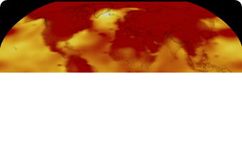

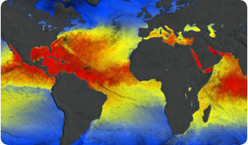

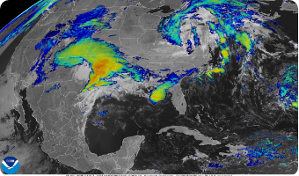
REGIONAL ANALYSIS
Ablation Impact Across Global Regions
High Latitudes & Poles
Equatorial Convection
Mid-Latitude Storm Tracks
Geocyclic Padding eliminates edge distortion, drastically reducing polar temperature error.
SENet improves tropical Z500 ACC by dynamically weighting multi-layer wind and pressure features.
Combined architecture maintains continuous jet stream dynamics without artificial lateral damping.
https://svs.gsfc.nasa.gov/vis/a000000/a005400/a005450/2024GISTEMPMap.png
https://earthdata.nasa.gov/s3fs-public/styles/hds_hero_half/public/2025-11/ccmp-project-hero-1.jpg?VersionId=zACjBMdhhsKdXUC8XWQsKSU4u8ekZ0GV&itok=vQPE6D5d
https://substackcdn.com/image/fetch/$s_!_9E9!,f_auto,q_auto:good,fl_progressive:steep/https%3A%2F%2Fsubstack-post-media.s3.amazonaws.com%2Fpublic%2Fimages%2F0b6f502e-50d4-4403-8db7-0f0639c9f281_2500x1500.jpeg

Slide 8
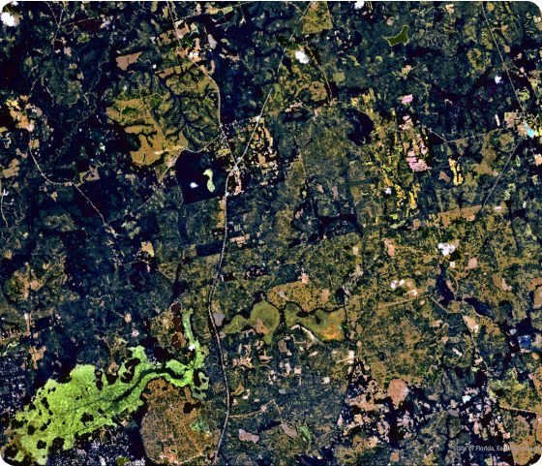
IMPACT
Key Takeaways
Proof of Green AI: Smart design beats raw compute scaling.
Surpasses Tradition: Beats ECMWF S2S operational models.
Global Access: Runs forecasts locally on small GPU clusters.
https://blog.wfsu.org/blog-coastal-health/wp-content/uploads/2025/09/Hyperspectral_True_Color-1200-copy.jpg

Slide 9
Thank You

Slide 10






Image Sources
https://nvidianews.nvidia.com/_gallery/get_file/?file_id=682989ae3d6332f015179abf
Source: nvidianews.nvidia.com
https://elements-resized.envatousercontent.com/elements-video-cover-images/2ee0cc55-7376-4c5b-83b9-79768a13fb83/video_preview/video_preview_0000.jpg?w=500&cf_fit=cover&q=85&format=auto&s=ad6f66c219e04d5e23509c627e5cd217a4dd527d4fab84887f60af5f52ff5f11
Source: elements.envato.com
https://wmo.int/sites/default/files/2023-11/Screenshot%202023-11-24%20at%2015.04.32.png
Source: wmo.int
https://cdn.britannica.com/03/5503-050-184F70BE/surface-pressure-altitude-Earth-Examination-data-relationship.jpg
Source: www.britannica.com
https://media.istockphoto.com/id/1903972230/photo/top-view-green-forest-with-globe-earth-sustainable-environment-concept-carbon-reduction.jpg?s=612x612&w=0&k=20&c=WGWQakldNZLqVBY6Gfzuvr5JvjjUoPAW8XV7OELQt6Y=
Source: www.istockphoto.com
https://svs.gsfc.nasa.gov/vis/a000000/a005400/a005450/2024GISTEMPMap.png
Source: svs.gsfc.nasa.gov

